Slide 1
From Spatial Computing to
Tactical Command of Swarms
Jacob Beal
2012 AAAI Fall Symposium:
Human Control of
Bio-Inspired Swarms
November, 2012
Work partially sponsored by DARPA; the views and conclusions contained in this document are those of the authors and not DARPA or the U.S. Government.
Notes:
Pre-introduction: http://www.youtube.com/watch?feature=endscreen&v=vjRPla0BONA&NR=1
Start around 0:16

Slide 2
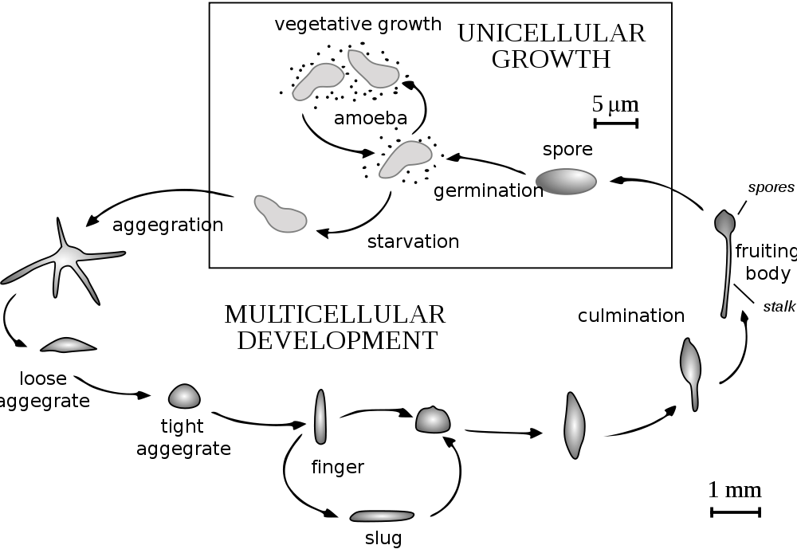
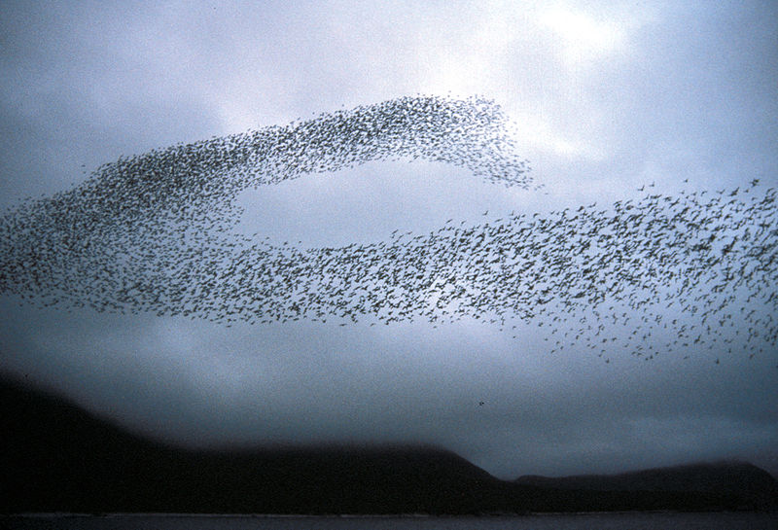
Composable Aggregate Programming
Biological Inspiration
Continuous Space-Time
Computational Model
Complex Engineered Self-Organization

Slide 3
Let’s talk about composition…
Realistic applications demand many interacting behaviors…
Need precise semantics, simple enough for mission experts
Emergence Basis Set → Behavior Group

Slide 4
Amorphous Medium
device
neighborhood
Continuous space & time
Infinite number of devices
See neighbors' past state
Approximate with:
Discrete network of devices
Signals transmit state
Density, mass flow = Mobile devices
State of matter = Degree of mobility
[Beal, UPP 2004] [Bachrach, Beal & McLurkin, NCA 2010]

Slide 5
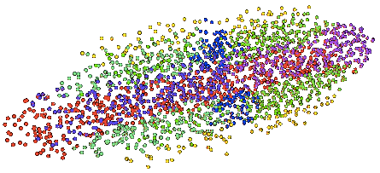
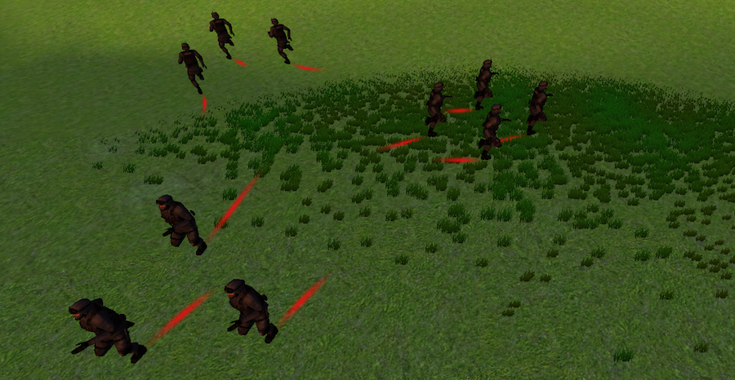
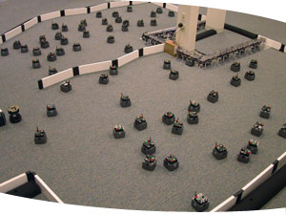
Some Recent Applications
Synthetic Biology
Morphogenetic Models
Agent-based tactical simulation
Robot Swarms
[Beal et. al., ACS Syn.Bio. 2012] [Beal et al., GECCO 2012]
[Beal, Usbeck & Krisler, SCW 2012] [Bachrach, Beal & McLurkin,NCA 2010]

Slide 6
Geometric Program: Move Through
Moving
Unit
Desti-
nation

Slide 7
Field Dataflow Computation
destination
disperse
distance-to
grad
flock
unit
mux
Notes:
Functional computation on time-dependent fields

Slide 8
Proto
(def distance-to (src) ...)
(def grad (values) ...)
(def flock (preferred) …)
(def disperse () …)
(def move-through (selected target)
(let ((path (grad (distance-to target)))
(fill-in (disperse)))
(if target (tup 0 0 0)
(if selected (flock path) fill-in))))
evaluation
global to local
compilation
Global Local Discrete
platform
specificity &
optimization
device
neighborhood
discrete
approximation
Device
Kernel
[Beal & Bachrach, IEEE Intel.Sys. '06]

Slide 9
Proto's Families of Primitives
Pointwise
Restriction
+
restrict
Feedback
Neighborhood
41
7
delay
+
nbr
any-hood
48
Formal semantics: [Beal, Usbeck & Benyo, Comp.J. 2012], [Viroli, Beal & Usbeck, Sci.Comp.Prog. 2012]

Slide 10
Benefits of Manifold Model
Simplicity
Scalability, robustness, adaptability
Simpler proofs and composability
Self-stabilization
Convergence
(let’s go see some examples in simulation)

Slide 11
Tactical Command Architecture
Build on top of continuous space model with:
Modulation by autonomic management layers
Basis set of “maneuvers”
(let’s go see modulation in action in simulation)

Slide 12
What’s a good maneuver basis set?
Some things that are easy to do…
Geometry:
…
0th moment
1st moment
2nd moment
Topology:
Composition:
Delegation
Parallel
Sequence
Piecewise
Linear blend
…
Separate
Connect
…but probably not high enough level

Slide 13
Contributions & Future Directions
Continuous manifold approach to composition
Proposed tactical architecture
Future research directions:
What is a good maneuver basis set / playbook?
Faster algorithms than current diffusion-based primitives
Graphical command UI
Strengthen composability results

Slide 14
Acknowledgements
Aaron Adler
Brett Benyo
Taylor Campbell
Jeff Cleveland
Joe Loyall
Susan Katz
Brian Krisler
Gretchen Markiewicz
Katie McGuire
Hala Mostafa
Rick Schantz
Kyle Usbeck
Fusun Yaman
Ron Weiss
Jonathan Babb
Noah Davidsohn
Mirko Viroli
Matteo Casadei
Jonathan Bachrach
Douglas Densmore
Evan Appleton
Swapnil Bhatia
Traci Haddock
Viktor Vasilev
James McLurkin
Annan Mozeika
Ben Axelrod

